Slide 1
Image Processing AI run by Raspberry Pi 4 using Edgetpu Coral over virtual, P2P, and decentralized network
Christian Flores
Computer Science
Mentor: Lei Xu
Computer Science

Slide 2
Motivation

Slide 3
Methods
My methodology was to collect data on the speed at which a Raspberry Pi models a Tensorflow AI using the Edge TPU Coral and the effects it has on performance over virtual, peer to peer, and decentralized networks.

Slide 4
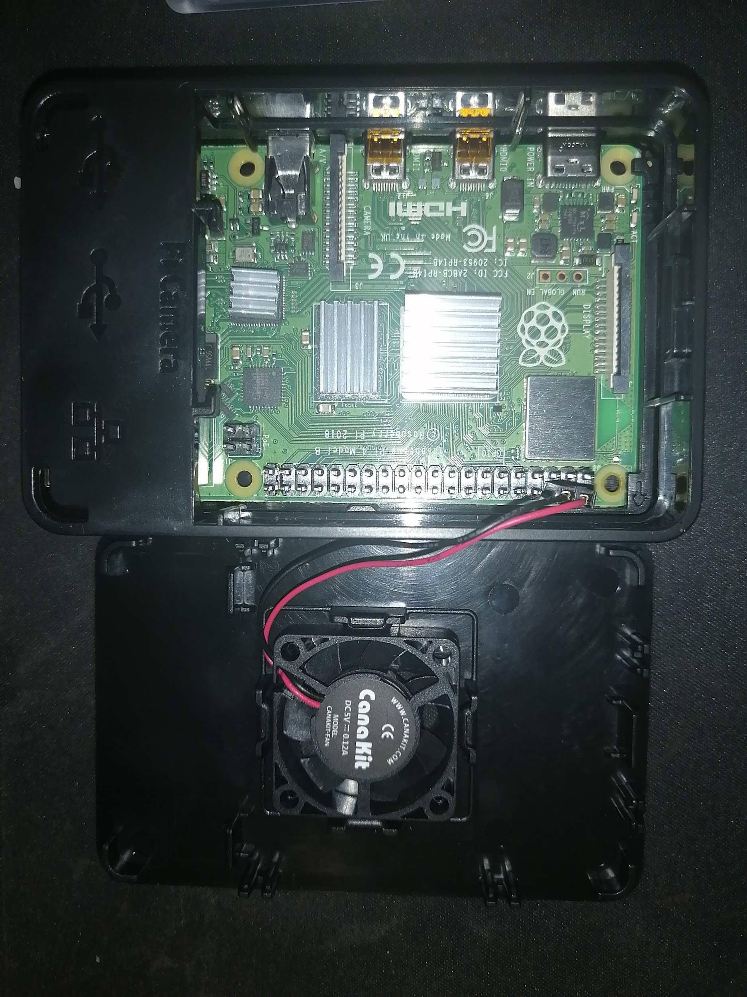
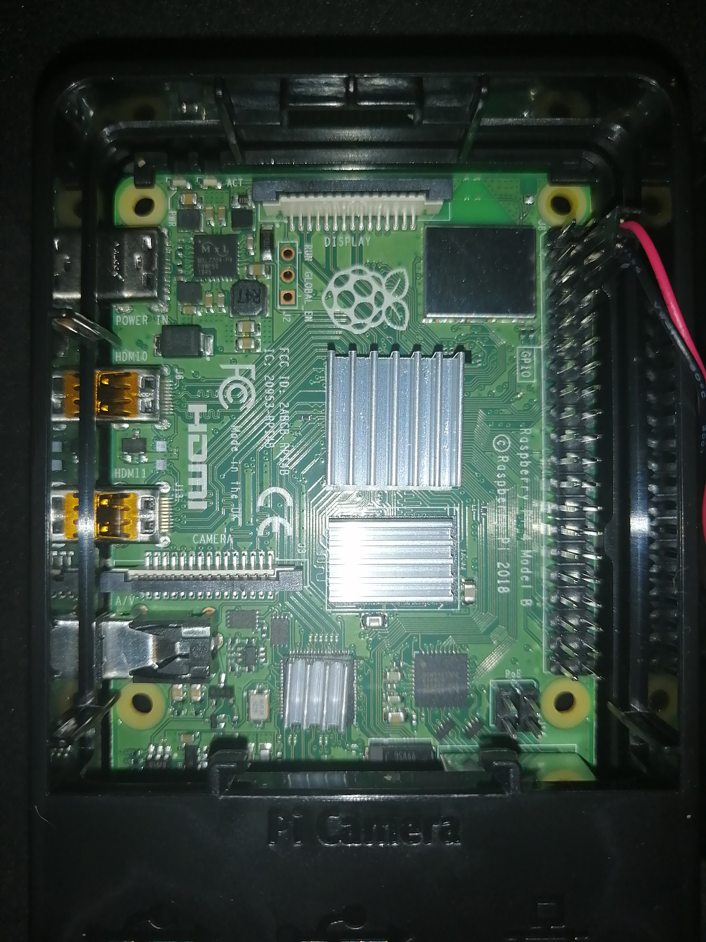
Raspberry Pi 4
The Raspberry Pi 4 is the latest version of Raspberry Pi which are small and cost effective computers that come with a 64-bit quad-core ARMv8 processor, a 32-bit Raspbian OS as well as 4GB of RAM

Slide 5
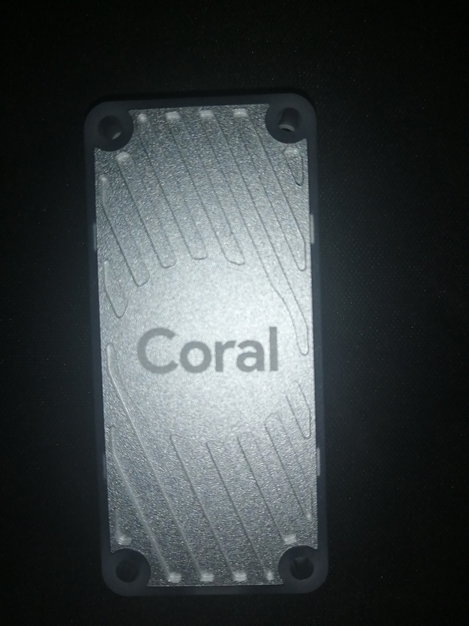
USB Accelerator Coral
The USB Accelerator is a tensor processing unit created by Google which helps accelerate AI applications. This device accelerates IoT devices making it possible to run AI models at a decent rate.

Slide 6
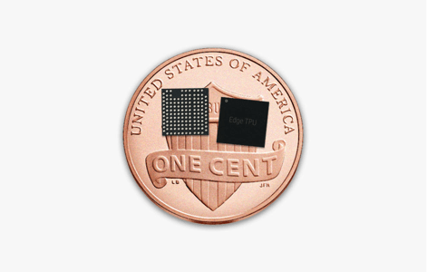
Notes:
https://cloud.google.com/images/products/edge-tpu/penny-edge-tpu.png

Slide 7
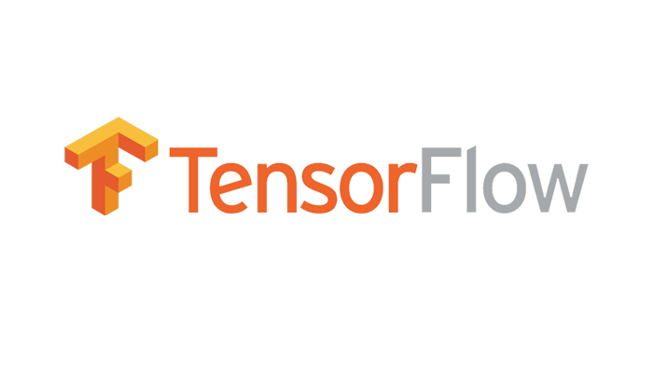
IoT TensorFlow Lite Models
Tensorflow is an open source software that focus on math libraries as well as AI models. There Tensorflow lite models allow IoT devices a range of functions from classification of images, objection detection, pose estimation, and text classification.

Slide 8
Testing
I tested the different speeds of the the image classification model based on the frames per second as well as the latency between the output to give a value to their total performance. I collected the data over 3 networks while alternating the edge tpu std and max libraries as well as testing the Raspberry Pi by itself.

Slide 9
Standalone Raspberry Pi
The standalone Raspberry Pi did not provide much computational power and the most frames it could produce did not surpass 5 FPS. The opposite was true when combined with the edge tpu running in standard mode which at the minimum had 16 FPS.

Slide 10
Standalone Raspberry Pi
Frame per Second
Case
 | Min | Average | Top
Without TPU | 4 | 4 | 5
With Std TPU | 16 | 20-22 | 26
With Max TPU | 16 | 22-24 | 29

Slide 11
Virtual Network
I used VNC Viewer and VNC Server to host a virtual network between the raspberry pi and a local pc. This used my local router to connect both devices and allow me to control the raspberry pi over the network at a latency of about a second.

Slide 12
Virtual Network
Frame per Second
Case
 | Min | Average | Top
Without TPU | 4 | 4.4 | 5
With Std TPU | 14 | 18-20 | 26
With Max TPU | 16 | 20-23 | 29

Slide 13
Peer to Peer
To connect the PC to the Raspberry Pi I used Ad Hoc to allow P2P. Which allowed me to view and control the application with Secure Shell with x11 enabled and Xming. This was not as effective, as the Raspberry Pi also had to handle ip addressing.

Slide 14
Peer to Peer Latency
Latency
Case
 | (Seconds)
Without TPU | 26
With Std TPU | 9
With Max TPU | 9

Slide 15
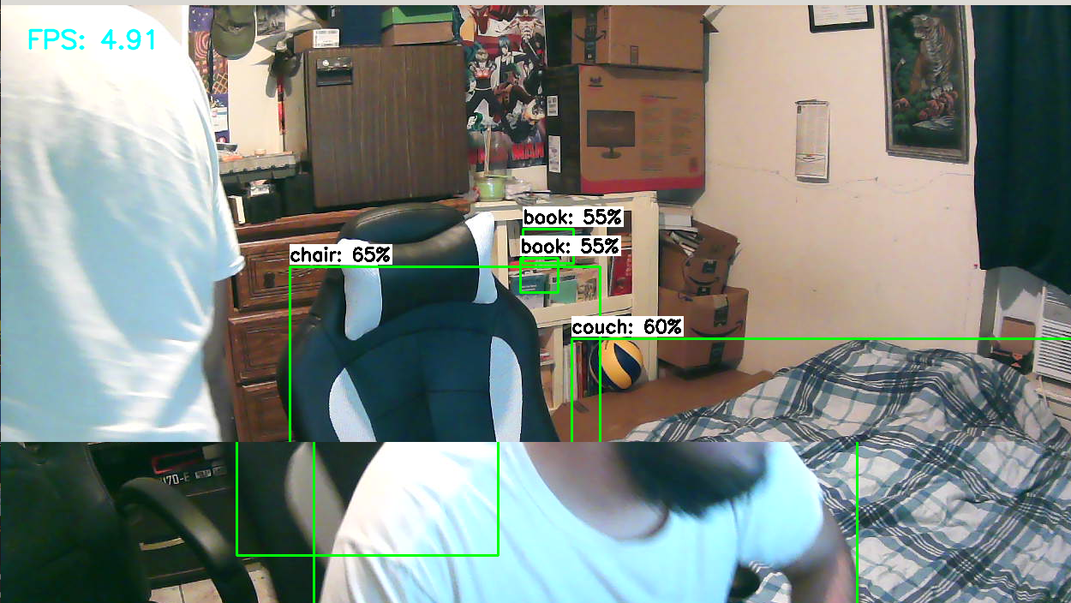

Slide 16
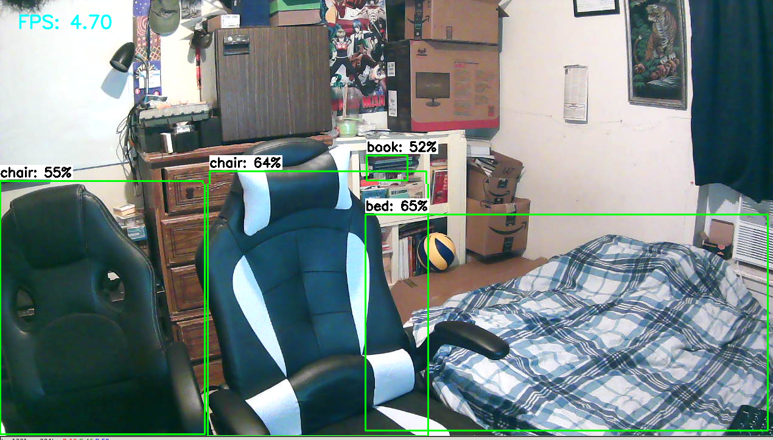

Slide 17
Peer to Peer
Frame per Second
Case
 | Min | Average | Top
Without TPU | 4 | 4 | 5
With Std TPU | 16 | 17-18 | 22
With Max TPU | 16 | 20-23 | 25

Slide 18
Decentralized Network
Hyperledger Fabric is a decentralized blockchain network that allows contracts to be changed while the network is running. Although Raspberry Pi 4 has the capabilities to run 64 bit OS it does not come with a 64 bit OS as the 32 bit Raspbian is more stable due to it being the standard.

Slide 19
Conclusion
The overall performance of the Google Edge TPU Coral makes it a must when thinking about using AI in any project as it enhances IoT possibilities

Slide 20


Acknowledgements
This summer research was funded by LSAMP and UTRGV to help students like myself experience research in an area of STEM. Thank you mentors for helping us in our research this summer.

Slide 21
References

